Slide 1
Introduction to app development & Flutter
Narayan vyas
Sr. Developer, Flexxited

Slide 2
Mobile app development
Mobile application development is the process of creating software applications that run on a mobile device, and a typical mobile application utilizes a network connection to work with remote computing resources.

Slide 3
App development approaches
Various Technologies are used for Mobile App Development which are classified as –
Native Approach
Hybrid Approach
Cross-Platform Approach

Slide 4
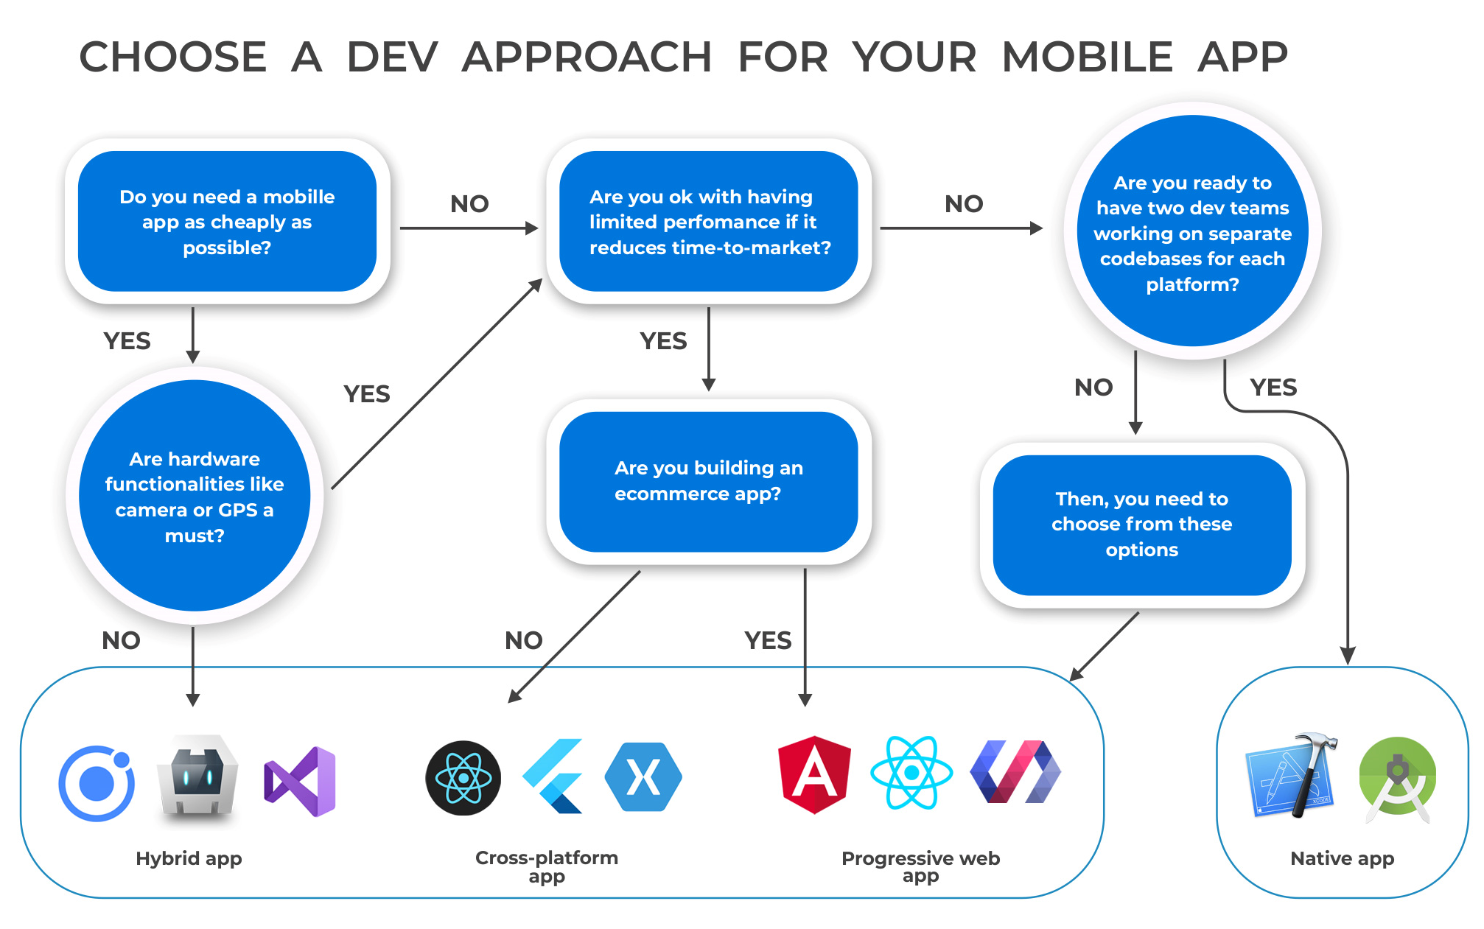

Slide 5
What is flutter?
Flutter is an open-source UI software development kit created by Google. It is used to develop cross platform applications for Android, iOS, Linux, Mac, Windows, Google Fuchsia, and the web from a single codebase.
The first version of Flutter was known as codename "Sky" and ran on the Android operating system.
Initial release date of Flutter was May 2017.

Slide 6
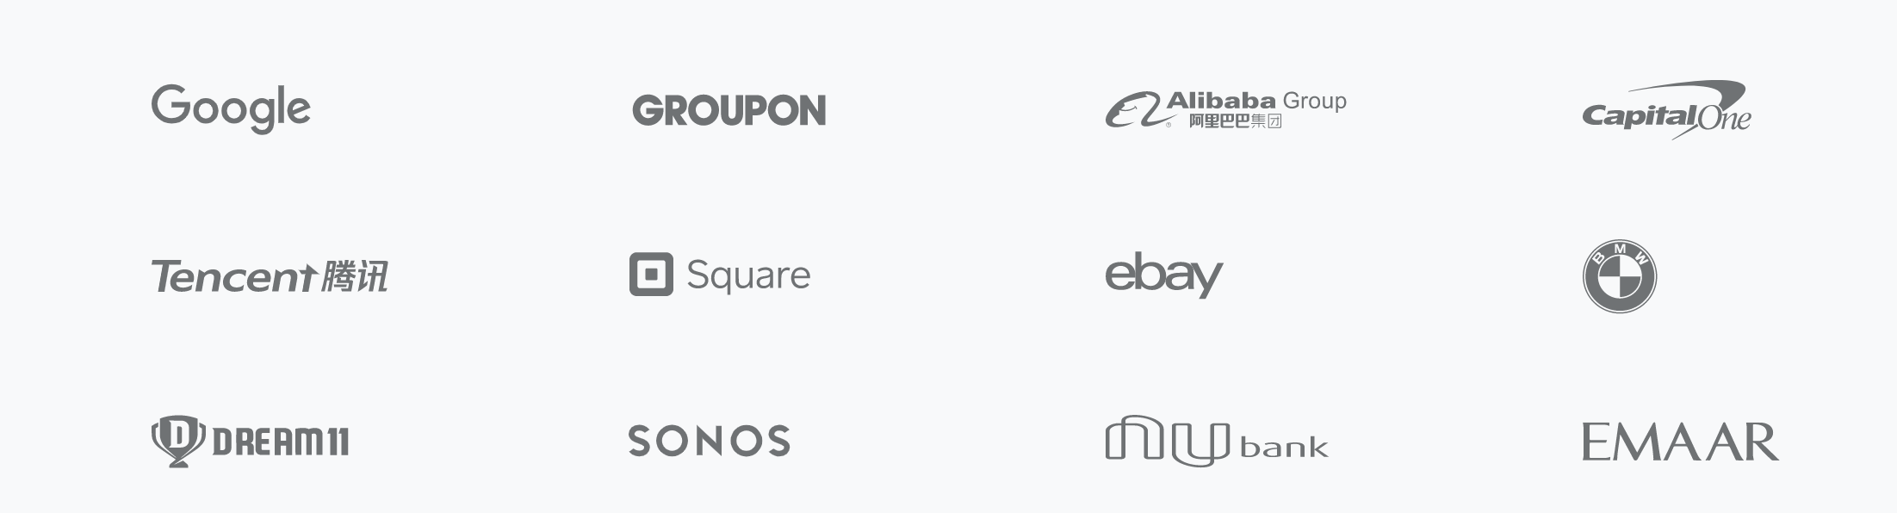
organizations working with Flutter

Slide 7
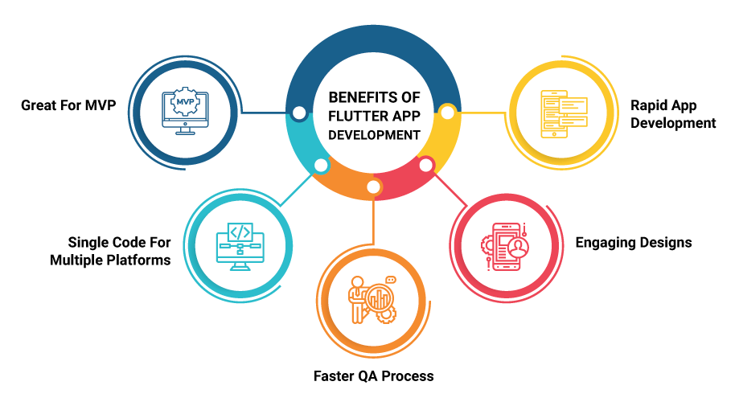
Why flutter

Slide 8
What are widgets?
Flutter widgets are built using a modern framework that takes inspiration from React. The central idea is that you build your UI out of widgets.
Widgets describe what their view should look like given their current configuration and state. When a widget’s state changes, the widget rebuilds its description

Slide 9
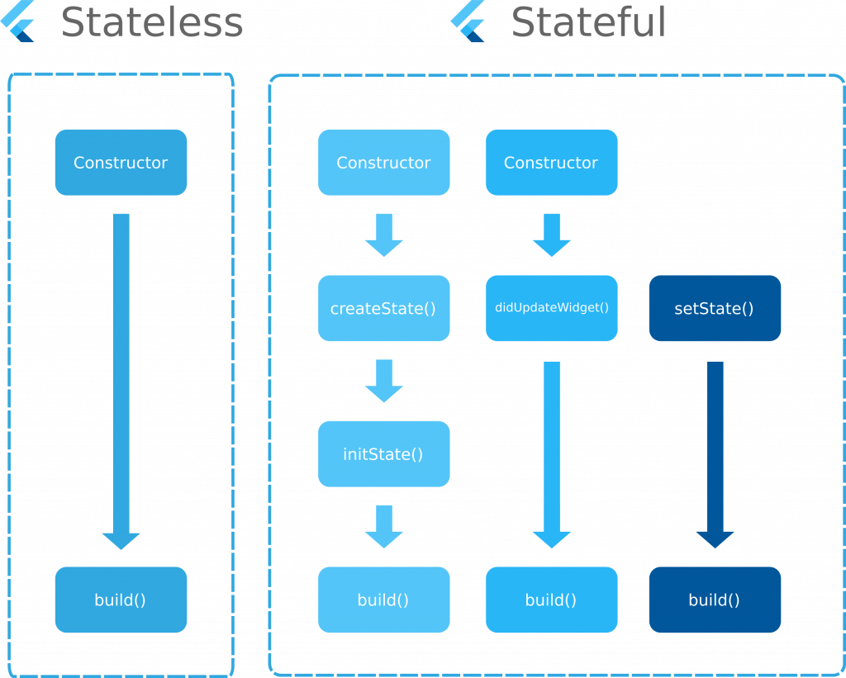
Cannot be updated on user interaction
Shortcut - stl
Can be updated on user interaction
Shortcut - stf

